Slide 1
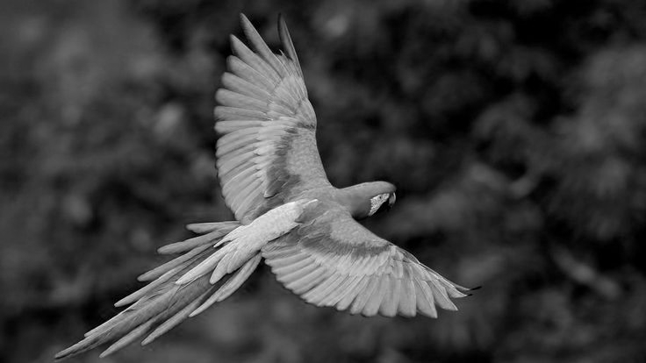

An Empirical Approach: Few-Shot Study
Group BB
Jacopo D‘Angelo | 3161719
Maximilian Rienth | 3325056
Ioannis Thomopoulos | 3176145

Slide 2
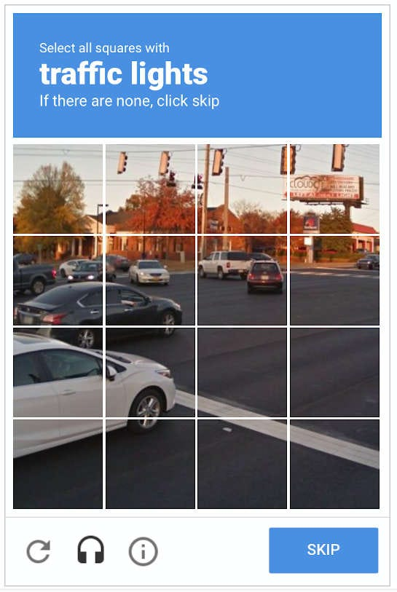
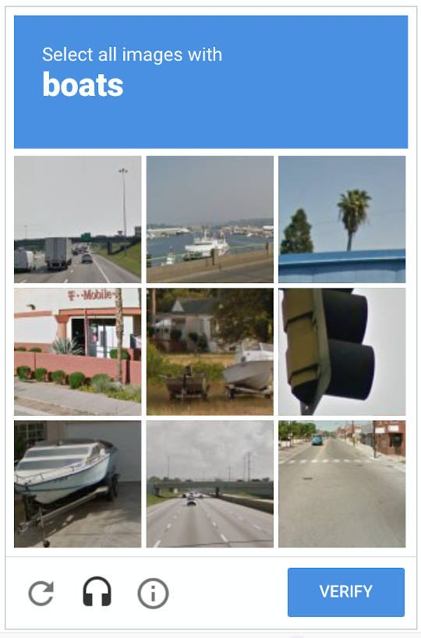


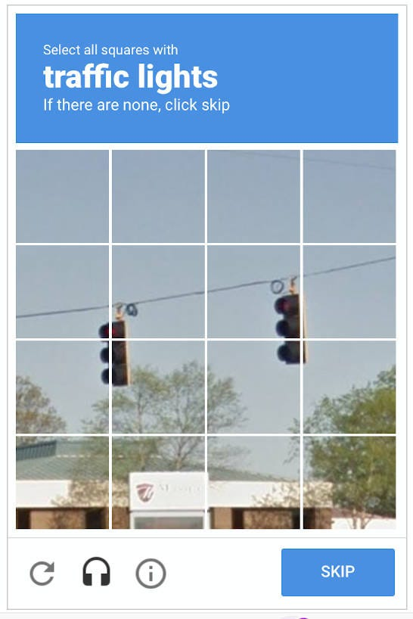

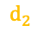
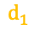
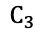
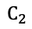
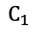
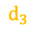
Classify new CAPTCHA types from few Examples
Starting Point: Visual CAPTCHA are designed to distinguish humans from automated bots.
Few-Shot Classification with Prototypical Network 5 Way: Sample 5 Classes per iteration 5 Shot: Sample 5 Images per Class and Average their Embedding Query Image: Classify Query Image based on closest Class Centroid
$$d_{1}$$
$$C_{1}$$
$$d_{2}$$
$$d_{3}$$
$$C_{2}$$
$$C_{3}$$
Challenge: CAPTCHAs templates are always evolving.
Prototypical networks adapt to new CAPTCHA types instantly by computing class centroids from 5 examples → No model retraining required.

Slide 3

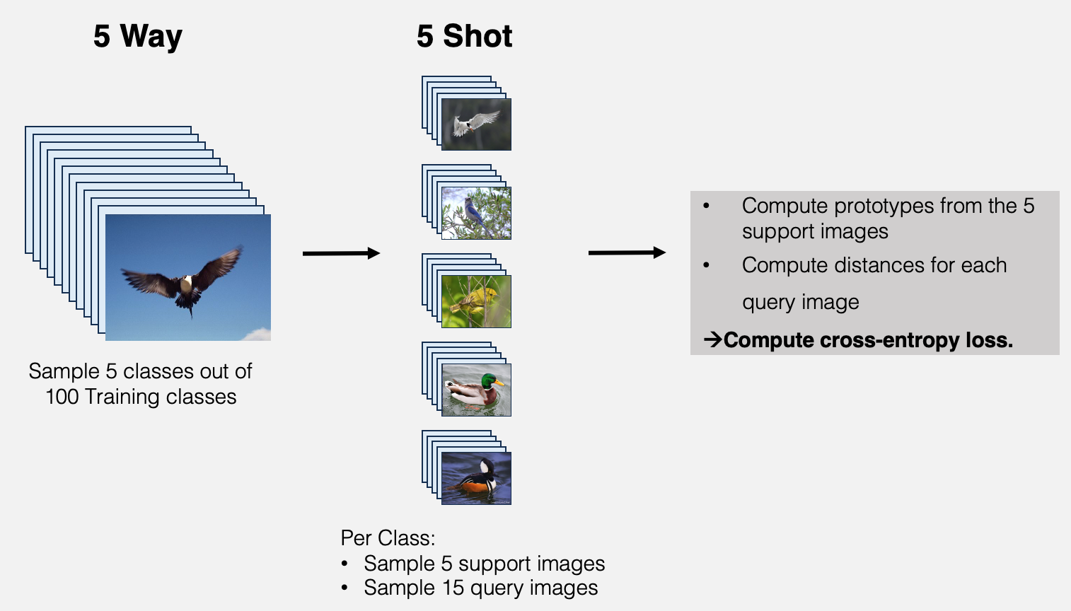
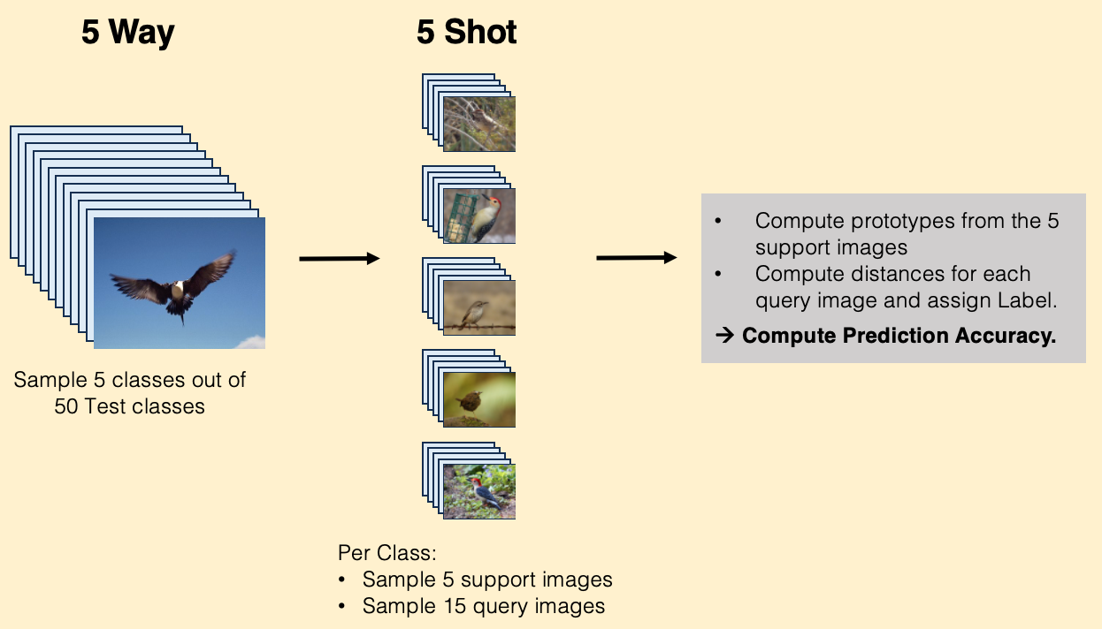

Meta-Training & Meta-Testing (Episodic Regime)
Meta-Training
Run 100 Epochs
(with early stopping based on Validation Accuracy)
Meta-Test
500 Episodes per Epoch
Run 500 Episodes per Epoch
Run 600 Episodes
Episode
Run 100 Validation Episodes
(on Validation Class)

Slide 4
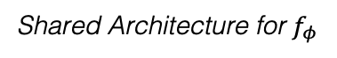
Protonet with CNN vs Transformer Models Backbone
CNN Models ResNet18
Baseline | Frozen ImageNet-pretrained ResNet18 No Training
One-Layer | Same frozen backbone, but with a small trainable linear projection
Two-Layer | Adds a non-linear two-layer projection on top of the frozen backbone
Fully-Tuned | Entire ResNet18 is trainable
Transformer Models ViT-B/16
Baseline | Frozen ImageNet-pretrained ViT-B/16 No Training
One-Layer | Same frozen backbone, but with a single trainable linear projection
Two-Layer | Adds a non-linear two-layer projection on top of the frozen backbone
Fully-Tuned | Entire ViT-B/16 is trainable
Shared Architecture for $f_{φ}$
Feature Extractor
Projection Head
L2 Normalization
Prototypical Classifier
Input (3, 224, 224)
ResNet 18 or
ViT-B/16
0-2 layers + ReLU
Compute class prototypes Euclidian Distance to Prototypes

Slide 5

Unexpected Discovery: Finetuning Degrades Performance
 | Observation on CAPTCHA Dataset: Any form of adaptation beyond a fully frozen back-bone consistently degraded performance! Accuracy: Frozen > 1-Layer > 2-Layer > Fully-Tuned for both Backbones
 | Initial Hypothesis: Dataset Issue! Only 11 classes (too few for few-shot?) Classes span different visual domains (text, objects, scenes) Limited training data (11k images total)
Validation: To address this, we incorporated the CUB-200-2011 birds' dataset as a more standard benchmark commonly used in few-shot classification.

Slide 6
Troubleshooting #1: Is it the Dataset?
 | CAPTCHA | CUB
 | 5-Shot
Baseline | 0.779 | 0.911
One-Layer | 0.532 | 0.814
Two-Layer | 0.488 | 0.768
Fully-Tuned | 0.446 | 0.742
Baseline | 0.898 | 0.927
One-Layer | 0.543 | 0.848
Two-Layer | 0.518 | 0.811
Fully-Tuned | 0.617 | 0.755
Despite changing to the CUB dataset which is widely used in Few-Shot literature the same counterintuitive results appear
Still holds:
 | ”Any form of adaptation beyond a fully frozen back-bone consistently degraded performance!”
Alternative Hypothesis: |  | Implementation Issue
CNN
Transformers

Slide 7
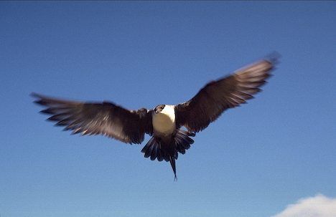
Troubleshooting #2: Is it the Baseline Model Implementation?
Concern: The issue might stem from our few-shot evaluation pipeline
Sanity check: Used the official Baseline++ code from Chen et al. (2019) Replaced their backbone with our weights This is comparable to our baseline because the only difference is the way the class prototypes are being computed (average class embeddings vs. learned prototypes).
Our Baseline | Chen et. al
5-Shot
91.13% | 91.05%
Baseline++ Architecture from Chen et al. (2019) → Executed their code
→ The Accuracies being almost the same leads us to conclude that it was not an issue in baseline model implementation!
Pre-trained weights (Image-Net)
Fine-tuned on Test Class
ResNet 18
Cosine
Classifier
CUB Dataset

Slide 8
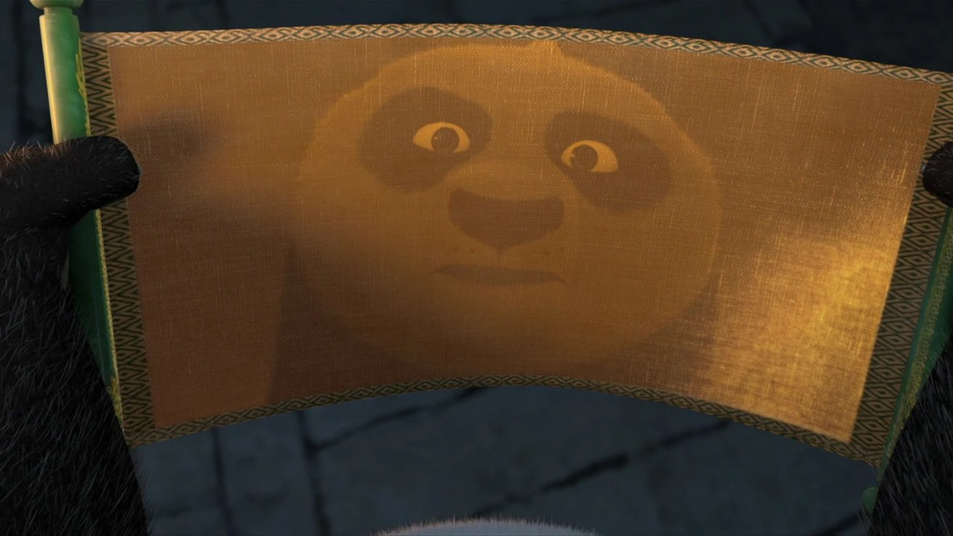
Why do we have this persistent counterintuitive trend?

Slide 9
Moment of Reflection
Our Assumption
Finetuning the baseline will improve Few Shot performance
Comparing to Chen et. al on CUB
Frozen Backbone
ResNet18_Weights.IMAGENET1K_V1
+
Their Test Regime
Accuracy
0.91
Initial Assumption = Naive
 | We aren’t starting from a weak model which needs improvement We start from a Backbone that already has very strong performance
→
The only component left that could explain the degradation in performance is the episodic prototypical finetuning itself.
Notes:
⁠We began this whole project starting from the assumption that the finetuning of the baseline was necessary as we thought this would help to “adapt it” to the few shot case
•⁠ ⁠However, when we compare our sanity check (and thus our baseline) accuracy with Chen 2019s’ accuracy in the case where they pretrain on mini-imagenet and test on CUB (same case as ours) they get an accuracy of 62%
•⁠ ⁠Thus our initial assumption might’ve been wrong in that we aren’t starting from a weak model that needs improvement, but we are starting from a pretraining source that extremely strong
•⁠ ⁠Therefore the only component left that could explain the degradation in performance is actually the episodic prototypical finetuning itself

Slide 10
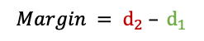
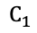
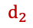
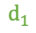
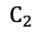
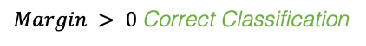
Training Does Not Heavily Overfit
 | Train |  |  | Test | Test
 | 5-Shot
One-Layer | 0.819 | > |  |  | 0.814
Two-Layer | 0.795 | > |  |  | 0.768
Fully-Tuned | 0.804 | > |  |  | 0.742
One-Layer | 0.873 | > |  |  | 0.848
Two-Layer | 0.873 | > |  |  | 0.811
Fully-Tuned | 0.838 | > |  |  | 0.755
Since classical overfitting is ruled out, we investigate an alternative explanation: Unstable Decision Boundaries
Margin Analysis quantifies how well-separated the correct class is from competing classes. This reveals whether episodic training creates consistent or unstable classification boundaries.
CNN
$$d_{1}$$
$$C_{1}$$
$$d_{2}$$
Transformers
$$C_{2}$$
$$Margin = D(Closest wrong Centroid) – D(Correct Centroid)$$
→ Training does not heavily overfit, so this cannot fully explain the drop in performance from Baselines.
$$Margin = d_{2} – d_{1}$$
$Margin > 0$ Correct Classification
$Margin ≫ 0$ “Confident” Correct Classification

Slide 11
Fine-tuning Creates Unstable Decision Boundaries
Margin Histograms (CNN)
Frozen (Base): Tight distribution → Stable class separation Margins are stable across episodes Largely greater than 0 Fine-tuned: Flat Distributions → Embedding space is unstable The same bird may get wildly different margins depending on which other classes appeared in the episode Result: Inconsistent predictions
→ But WHY does episodic fine-tuning cause this instability?

Slide 12
Episodic Finetuning Disrupts Resnet18’s Strong Geometry
What we know
ResNet18 was trained using standard supervised cross-entropy, not episodic few-shot learning. Research: Training episodically from scratch can eventually learn a consistent ProtoNet metric space
What we found
Applying episodic updates to a non-episodically trained backbone does not move the model toward an ideal ProtoNet solution. We disrupt the pretrained backbone’s strong geometry without gaining benefits of full episodic training.

Slide 13


Conclusion
Final Takeaways
Strong pretrained encoders do not benefit from episodic fine-tuning. The pretrained metric space is already highly effective for few-shot classification. ⁠Any adaptation or finetuning distorts the embedding geometry rather than improving it.
Future Analysis
⁠Explore if non-episodic fine-tuning strategies (which match the backbone’s pretraining) result in the same few-shot accuracy degradation pattern (Negative Correlation: Finetuning and Accuracy)
→ In few-shot: Either train episodically from scratch or use a strong pretrained backbone.

Slide 14
Appendix
Notes:
Many things have been done to compare LLM and BERT performances and extensive research

Slide 15
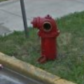
Appendix (1/2)
Resizing images to 224×224 pixels
Datasplit
50% Train Class
(100 Birds, 5 Captchas)
Datasets
CUB 11,788 labelled images Across 200 bird species Google reCAPTCHA V2 10,390 labelled images Across 11 categories
Data Augmentation
Random horizontal flipping (p=0.5)
Rotations +/- 10°
Color Jitter
25% Validation Class
(50 Birds, 3 Captchas)
25% Test Class
(50 Birds, 3 Captchas)

Slide 16
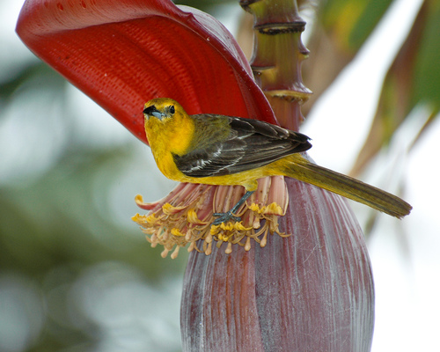
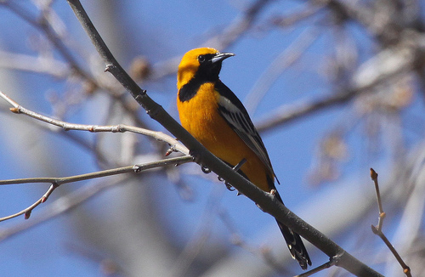
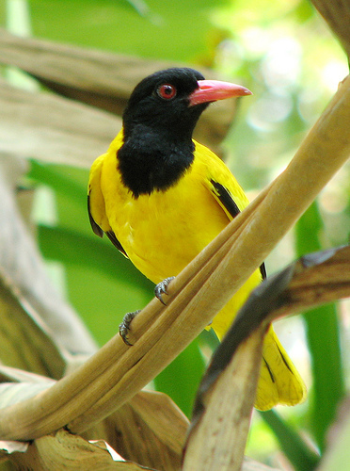
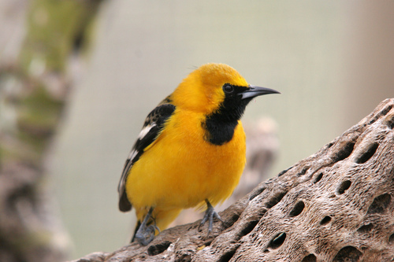
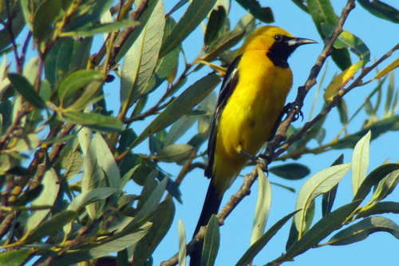
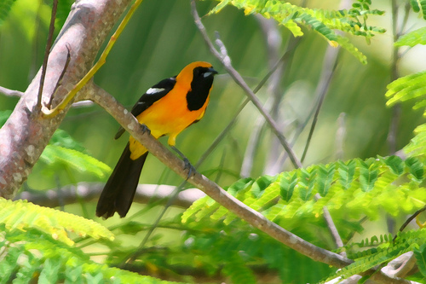
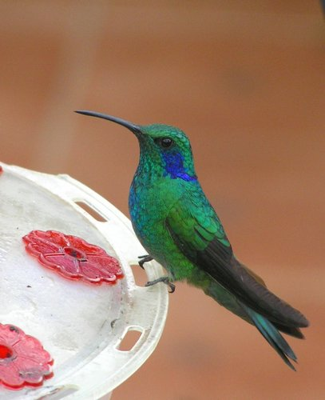
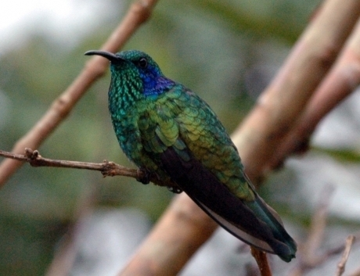
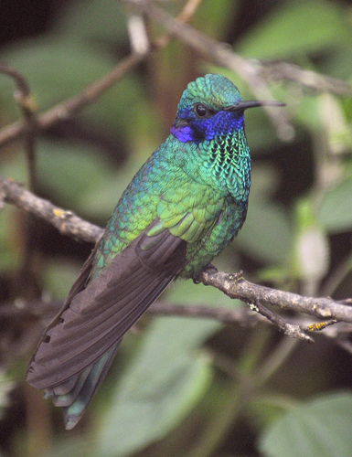
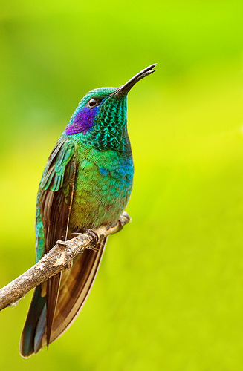
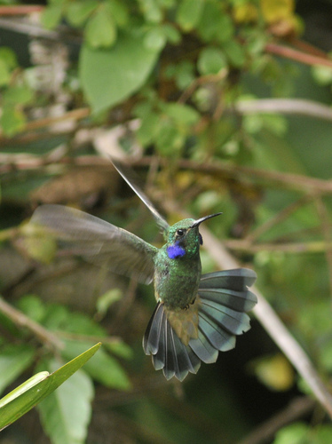
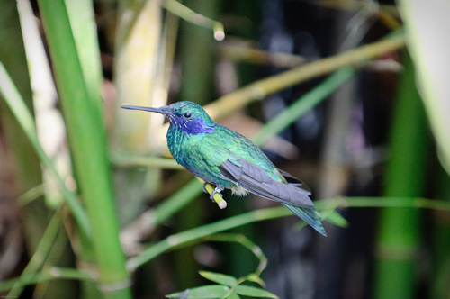
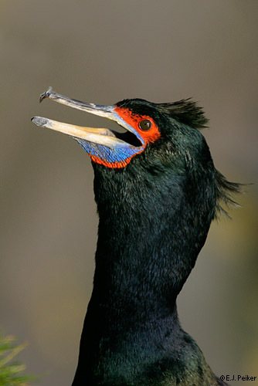
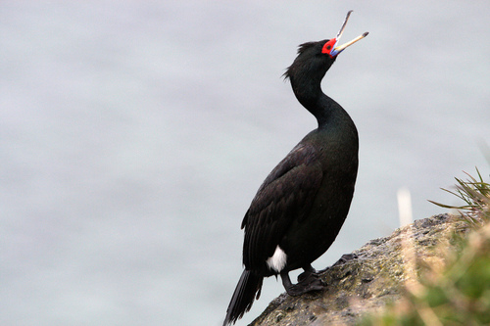
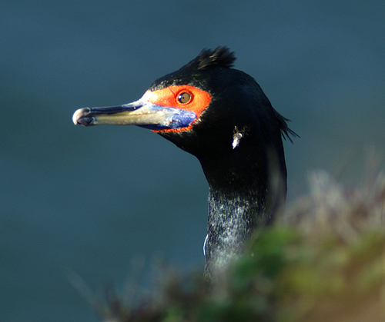
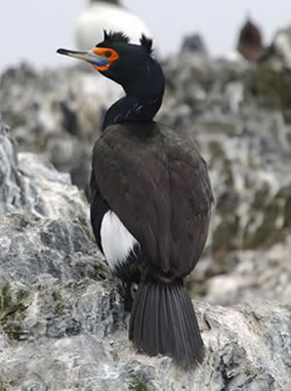
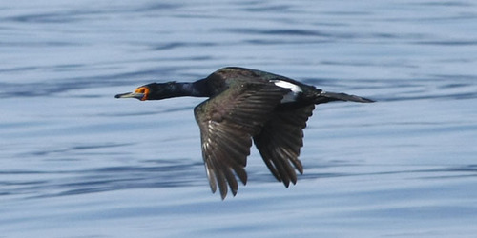
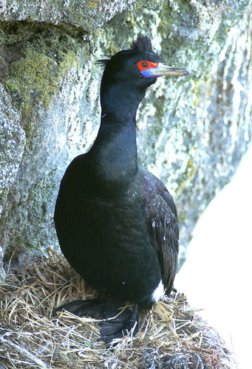
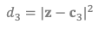
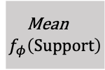
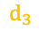
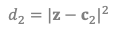
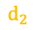
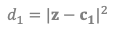
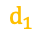
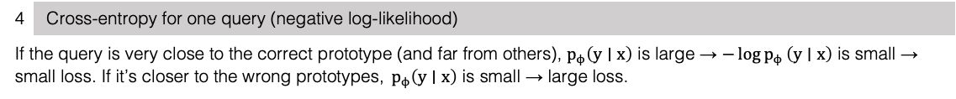
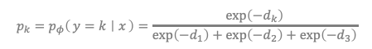
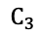



Appendix (2/2)
Support Images
1 | Distance Query to Prototype
Compute the squared Euclidean distance
2 | Turn Distances to Scores
Flip the sign of the distances
3 | Convert scores to probabilities
Apply standard softmax
Query Images
4 | Cross-entropy for one query (negative log-likelihood)
If the query is very close to the correct prototype (and far from others), $p_{ϕ}\left(y∣x\right)$ is large → $−\log{p_{ϕ}}\left(y∣x\right)$ is small → small loss. If it’s closer to the wrong prototypes, $p_{ϕ}\left(y∣x\right)$ is small → large loss.
$$d_{1}=|z−c_{1}|^{2}$$
$$d_{2}=|z−c_{2}|^{2}$$
$$d_{3}=|z−c_{3}|^{2}$$
$$s_{k}=−d_{k} \text{for} k=1,2,3.$$
$$d_{1}$$
$$p_{k}=p_{φ}\left(y=k ∣ x\right)=\frac{\exp\left(−d_{k}\right)}{\exp\left(−d_{1}\right)+\exp\left(−d_{2}\right)+\exp\left(−d_{3}\right)}$$
Mean$f_{φ}\left(Support\right)$
$$C_{1}$$
$$f_{φ}\left(Query\right)$$
$$d_{2}$$
$$d_{3}$$
$$C_{2}$$
$$C_{3}$$

